Slide 1

itecting
Living Systems
Moving beyond static products to achieve systemic autonomy and continuous evolution through Knowledge Engineering.

Slide 2
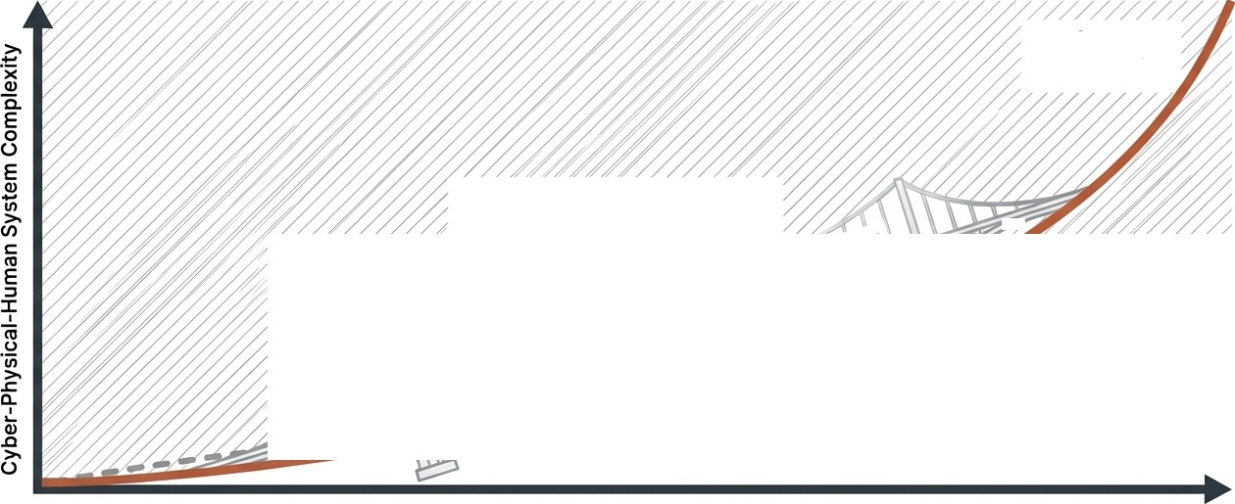






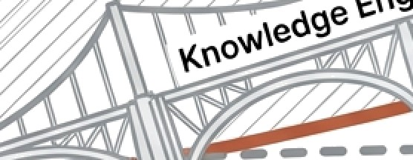

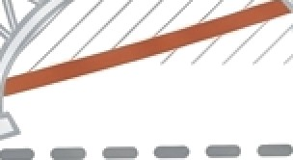
Compounding complexity has outpaced manual engineering capacity
Managing scale requires systems that can formally verify their own safety constraints.
System Complexity
The Complexity Wall
Time / Evolution
W NotebaokLM

Slide 3
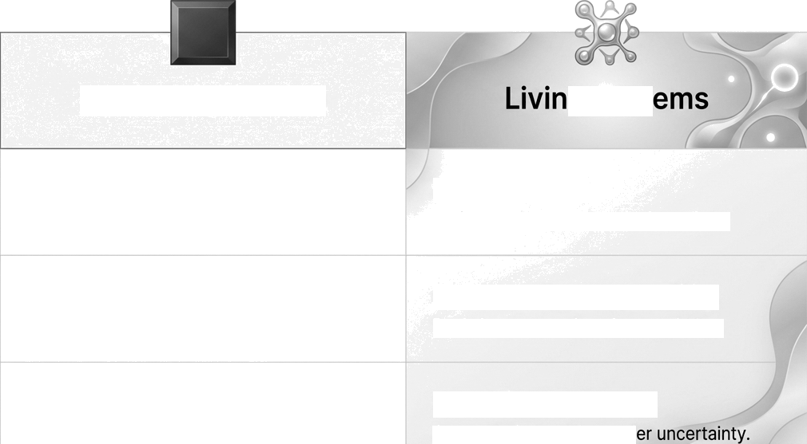
The evolution of the engineering paradigm
Static Engineering
g Syst
Output Target | Static Product Designed once, degrades over time. | Living System Self-optimizing, continuously evolves.
Process | Siloed Disciplines | Federated Interoperability
Architecture | Bottlenecked communication. | Real-time, cross-domain negotiation.
Control | Human Oversight | Cognitive Autonomy
Mechanism | Manual monitoring, script-based automation. | Automated reasoning und
W NotebaokLM

Slide 4
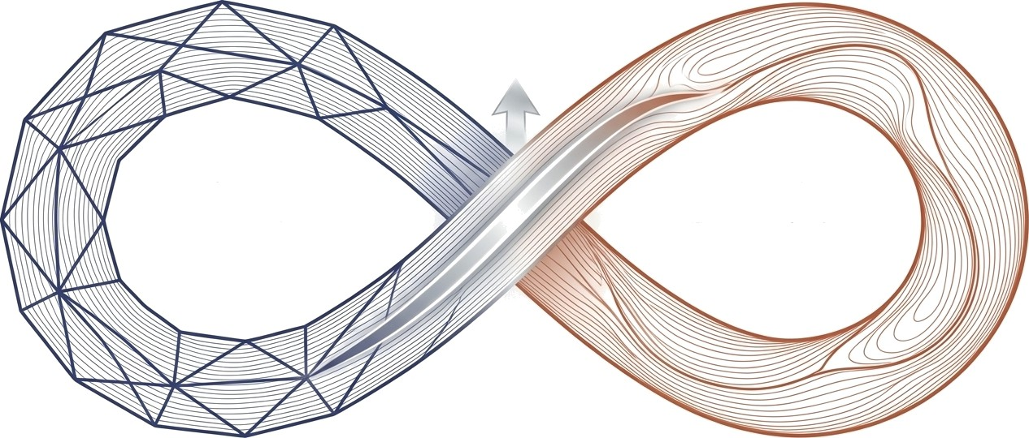


Closing the self-evolving engineering loop
Continuous feedback informs the next generation
Design-Time
From Templates
to Reasoning
Run-Time
From Monitoring to Self-Optimization
Semantic interoperability enables Generative Design that respects cross-disciplinary constraints.
Assets make autonomous decisions based on original design intent and real-world feedback.

Slide 5


Knowledge engineering unifies digital, physical, and biological lifecycles
Design-Time Constraints Run-Time Autonomy
Embedded computational requirements and constraints.
Self-healing code rewrites resource allocation logic; autonomous cybersecurity reasoning.
Generative design automatically accounts for a digital twin's data needs.
A bridge knows its structural limits and autonomously reroutes traffic if a sensor detects a crack.
Bio-foundries engineer complex living systems with circuit-board precision.
Bioreactors adjust chemical inputs in real-time by understanding the organism's metabolic pathway.
'
W NotebaokLM

Slide 6

Moving beyond the fragile single source of truth
Managing scale, complexity, and autonomy requires a federated topology distributed
across specialized domains to assure reliability and resilience.
Single Source of Truth
Single Version of Truth
W NotebaokLM

Slide 7
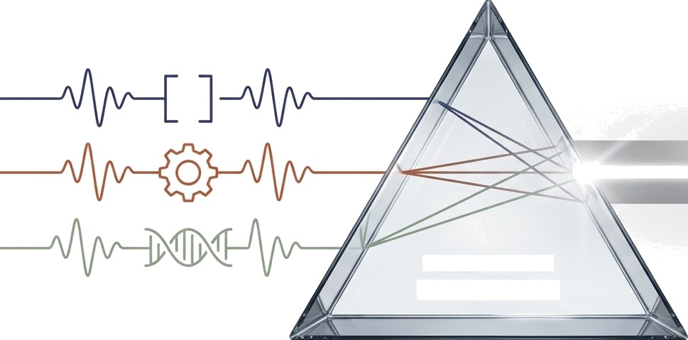
Breaking semantic silos through a Common Logic Layer
Common Logic Layer
(Semantic Interoperability)
Cross-Domain Ontologies (KE)
A ‘stress test’ means something different to every discipline. The Common Logic Layer translates domain-specific data (e.g., physical fatigue) into shared computational and biological impacts in real-time.
W NotebaokLM

Slide 8




The framework for a federated engineering ecosystem
Federated
Interoperability
Impact:
Design-time collaboration across global teams.
Outcome:
Reduced design cycles and the elimination of re-work.
Autonomous Reasoning
Impact:
Run-time safety checks and self-healing.
Outcome:
High reliability in unpredictable Edge environments.
Knowledge Graphs
Impact:
Traceability from
requirement to relirement.
Outcome:
Guaranteed regulatory compliance and safety through formal verification.
G Nc•tebookLM

Slide 9
Cognitive autonomy enables the self-evolving engineering loop
Adapt
The system autonomously reconfigures itself(Agility) without compromising underlying safety constraints (Reliability).
Observe
Assets collect real-time data at run-time (maintaining operational awareness).
Reason
The federated logic identifies more efficient operational pathways under uncertainty.
G Nc•tebookLM

Slide 10

The ultimate asset is the knowledge itself
The physical part may be replaced, and the specific algorithm rewritten, but the logic—the understanding of how the system interacts to stay safe, agile, and resilient—persists and evolves. We are no longer engineering things; we are engineering understanding.

